Slide 1
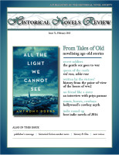
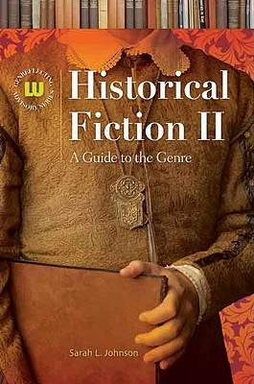
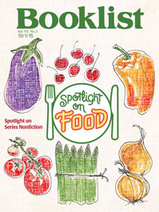


Introducing myself

Slide 2
THE SEVEN BASIC QUESTIONS
WHY do people read it?
WHAT is it?
HOW do you define it?
WHO reads it?
HOW MUCH of it is history, and how much is fiction?
WHEN does it take place?
WHERE can you find it?

Slide 3
“The past is a foreign country… they do things differently there.”
- L. P. Hartley

Slide 4
“All novels are historical… but some are more historical than others.”
- George Orwell
(sort of…)

Slide 5
“Nouns always trump adjectives, and in the phrase ‘historical fiction,’ it is important to remember which is which.”
- Thomas Mallon
(novelist and critic)

Slide 6

Historical fiction: my working definition
(most of the time)
“Historical fiction” encompasses fictional works (mainly novels) set more than 50 years in the past, ones in which the author is writing from research rather than personal experience.
Notes:
There has to be a cutoff point. What about YA books?

Slide 7
Historical fiction: my working definition
(for YA & children’s)
“Historical fiction” encompasses fictional works (mainly novels) set more than 50 35? 25? years in the past, ones in which the author is writing from research rather than personal experience.
Notes:
There has to be a cutoff point. What about YA books?

Slide 8
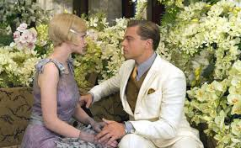
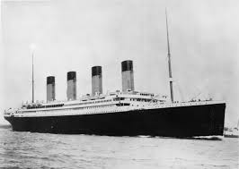
Popular trends and where they come from
Famous anniversaries
Benchmark titles that capture many readers’ attention
Films and TV miniseries
Serendipity!

Slide 9
Why write reviews?
Provide a professional service for librarians, booksellers, readers, and other book buyers
Participate in an ongoing conversation about books and literature
Encourage (or discourage) reading of books you loved (or hated)
See your name in print
Receive free review copies
Notes:
Beneficial to a field; professional benefits

Slide 10
Why write reviews?
Sharpen your critical evaluation skills
Develop stronger techniques for writing clearly and concisely
Keep up with authors and genre trends
Expand your reading horizons
Record impressions of what you’ve read
Meet others with similar reading tastes
Make a lot of money
Notes:
Beneficial to one’s own writing career; personal benefits

Slide 11
Why write reviews?
Sharpen your critical evaluation skills
Develop stronger techniques for writing clearly and concisely
Keep up with authors and genre trends
Expand your reading horizons
Record impressions of what you’ve read
Meet others with similar reading tastes
Make a lot of money
Notes:
Beneficial to one’s own writing career; personal benefits

Slide 12
Janice Harayda:
Eight tips for writing good book reviews
http://blog.netgalley.com/recipes-for-success-8-tips-for-writing-good-book/
Notes:
A recommended essay with guidelines for writing reviews

Slide 13
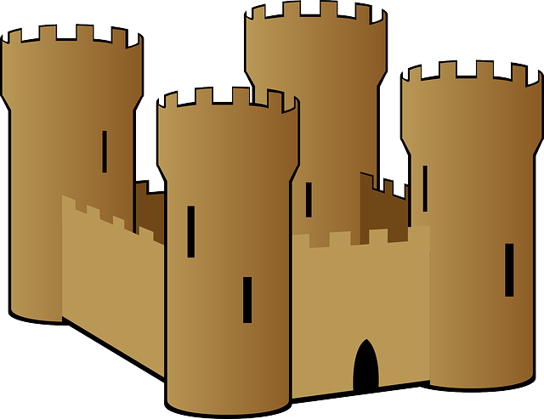
More tips for historical fiction book reviews
Mention the historical setting!
Balance plot and opinion
Back up criticism with examples
(including for anachronisms)
Gear your reviews to your audience
Write in an engaging style
Judge the book in front of you
(not the one you wish the author had written)
No spoilers! Except when the ending is a widely-known historical fact

Slide 14
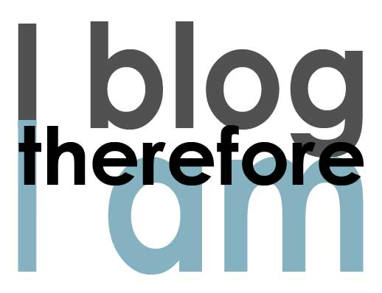
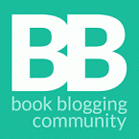
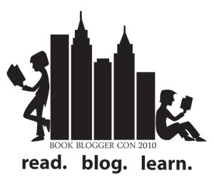


The rise of the book blog
Notes:
For my own blog, one of my deliberate aims was to keep my standards the same as I’d use for professional reviews. It was started 9 years ago, when book blogs were fairly new and being dissed by the literati.

Slide 15
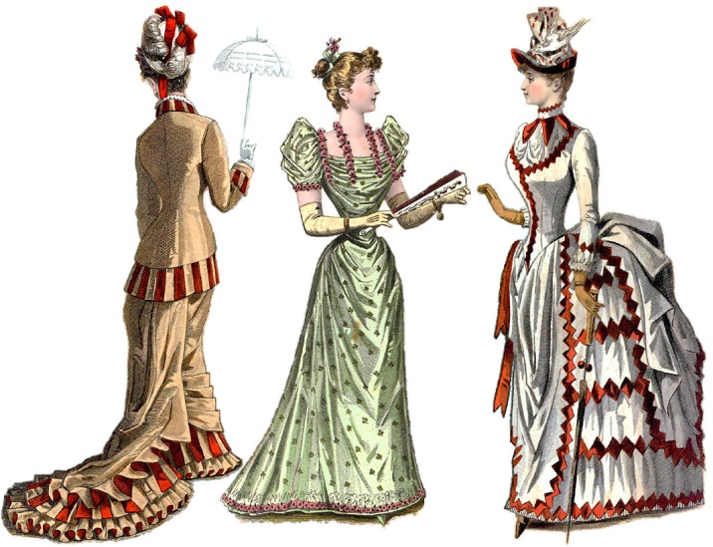
The historical fiction blogosphere
Reading the Past
HistoricalNovels.info
Novel Historian
Alex’s Bookshelves
(formerly The Children’s War)
Novel Pastimes
Unabridged Chick
Notes:
HF blogs with a variety of different focuses & styles.
More formal reviews vs. chatty and informative. See sidebar on my blog for more.

Slide 16
The KidLit blogosphere
Bloggers in children’s and YA literature
http://kidlitosphere.org/bloggers/

Slide 17
What’s the difference?
PROFESSIONAL REVIEWING | BOOK BLOGGING
Editorial oversight | Being your own boss
Word count limits | How lengthy? You decide
Reviews only | Plus interviews, opinions, chatter, guest posts – whatever you like
Minimal contact with publishers, authors, readers | Direct relationships with publishers, authors, readers
Deadlines to follow | Deadlines are self-imposed
Ethical considerations | Ethical considerations
May have a “house style” – depending on venue | Writing style? Can be casual or formal or anything in between. Up to you

Slide 18

Any questions?

